Slide 1
INVESTMENTS
Week 3: Asset Pricing Models 1
Vikas Raman

Slide 2
Outline
CAPM
Using the CAPM
estimating beta and the market risk premium
Testing the CAPM
Roll’s critique
Results
Explanations

Slide 3
The CAPM
Suppose you were a CAPM-style investor holding the world wealth portfolio, and someone offered you another stock to invest in.
What rate of return would you demand to hold this stock?
The answer before the CAPM might have depended upon the standard deviation of a stock's returns. After the CAPM, it is clear that you care about the effect of this stock on the TANGENCY portfolio.
The lower the average correlation a stock has with the rest of the assets in the portfolio, the lower its expected return!

Slide 4
A Revision Question
Suppose that you are holding a portfolio M and somebody offers you a share i, under what conditions would i help improve your portfolio?
we are looking for a precise answer:
Precise Answer: compute
α_{i} = E[R_{i}] – {R_{F} + β_{i}(E[R_{M}] - R_{F})}
if α_{i} > 0, you can improve your portfolio by buying Y
if α_{i} < 0, you can improve your portfolio by short-selling Y
if α_{i} = 0, you should neither buy nor short Y

Slide 5
Jensen’s Alpha
On the SML:
E[R_{i}]
B
E[R_{B}]
B is above the SML.
It has a positive alpha.
α_{B} > 0
E[R_{M}]
M
A is below the SML. It has a negative alpha.
Which one would you buy and which one would you short?
α_{A} < 0
E[R_{A}]
A
E[R_{M}]-R_{F}
R_{F}
C
0
β_{A}
1
β_{B}
β_{i}

Slide 6
Jensen’s Alpha
Definition: α_{i} = E[R_{i}] – {R_{F} + β_{i}(E[R_{M}] - R_{F})}
According to CAPM, equilibrium asset prices should make Jensen’s alpha equal to zero for any asset.
An asset with α_{i} > 0 offers expected return higher than the equilibrium. This asset is an attractive investment and therefore it must be underpriced.
An asset with α_{i} < 0 offers expected return lower than the equilibrium. This asset is not an attractive investment and therefore it must be overpriced.
Hence, Jensen’s alpha is an important performance measure.

Slide 7
Implications
If the portfolio M is mean-variance efficient, then by definition it cannot be improved by adding or subtracting any share to it
so for any share Y, α_{Y} = 0
Note 1: this is not some prediction or some theory that depends on efficient markets, rational investors, absence of taxes etc. It is a simple mathematical consequence of M being mean-variance efficient
Note 2: it holds whether the means, correlations and standard deviations are:
market consensus about the future,
my own subjective beliefs about the future based on my prejudices and private information
the historic (realised) behaviour of prices
though of course the portfolio M will differ in each case as will the interpretation of μ_{Y}

Slide 8
Using the CAPM
Valuation
the value of a company is the value of the cash flow it generates
forecast the cash flows of the company
estimate the beta of the cash flows
use the CAPM to get the discount rate:
Portfolio Construction
identify securities which are mispriced – off the SML
use portfolio optimiser to construct portfolio
Performance Measurement
see soon…
Need to estimate beta and market risk premium

Slide 9
Market Risk Premium – estimates from fundamentals
Dividend growth models
value of share is present value of future dividends
if dividend share of GDP bounded, long run dividend growth limited by growth in economy
MRP = return on equities – interest rate
= dividend yield + dividend growth – interest rate
dividend yield say 4%
dividend growth = GDP growth say 2%/year real
real interest rate say 2%
gives MRP of say 4%
Assumes that return to holders of shares comes solely and entirely from dividends, but if return comes from capital repayments (eg cash takeovers, share buybacks) or if substantial new share issues, argument does not work

Slide 10
Market Risk Premium – estimates from fundamentals
Implied MRP
Value of equity = Expected Earnings Next Period/Required Return on Equity
MRP = Required Return on Equity – Interest Rate
Example:
If S&P 500 Index is at 9000 and the expected earnings next period (value weighted average of all companies that constitute the index) is 900, then required rate of return on the US market (proxied by S&P 500) is 10%.
If the risk-free rate is 6%, then MRP = 10% - 6% = 4%

Slide 11
Market Risk Premium – estimates from fundamentals
From economics of risk aversion
The market risk premium exists to compensate people for the risk of the market
so the more risk there is in the economy, and the more people dislike risk, the higher the equity risk premium should be per unit of equity risk
risk aversion is measured by the risk aversion coefficient; 0 is indifference to risk, and the higher the number the more risk averse people are
experiments suggest that typical risk aversion is about 3 – implies that someone with wealth of 100 would be indifferent if offered a gamble which could equally send them to 90 or 114 (see next slide)
looking at consumption per head suggests that people do not face much risk in aggregate – consumption growth varies by about 1% per annum
Mehra and Prescott (1985) show in a simple model that the equity risk premium should equal market volatility (say 16%) x risk aversion coefficient (3) x volatility of consumption (1%) = 0.5% per annum – the Equity Premium Puzzle

Slide 12
Risk Aversion (Optional)
Economists assume people maximise the expected utility of wealth, where utility increases with wealth, but at a decreasing rate
A standard utility function is power utility, U(W) = W^{1-g} /(1-g) where g is the risk aversion coefficient
With g = 3, U(90) = -90⁻²/2= -6.2E-5; U(100) = -5.0E-5; U(114) = -3.8E-5
so 50% 90 + 50% 114 has same utility as 100

Slide 13
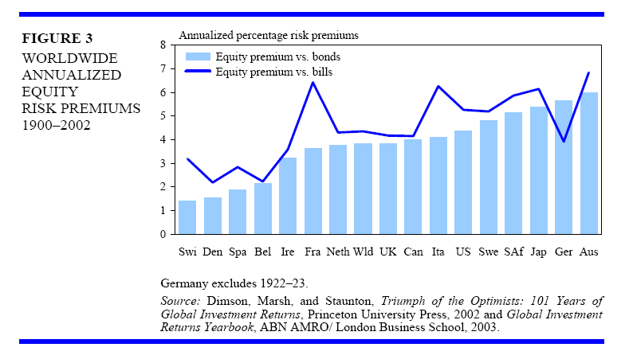
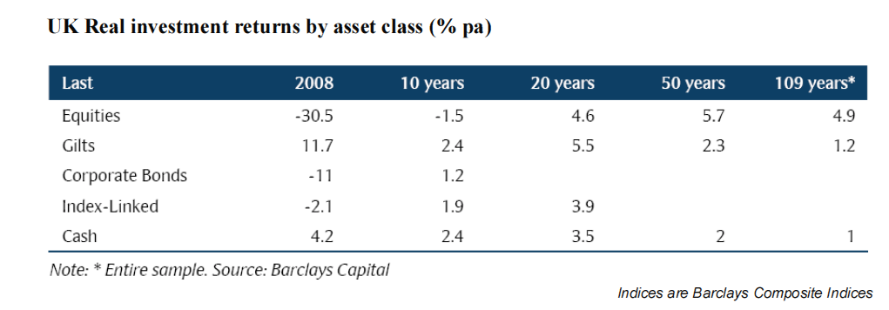
Some Data…
Source: Barclays Equity Gilt Study 2004
(figures for UK).

Slide 14
The Market Risk Premium - Empirical
Issues with historical premium.:
need very long run (standard error is σ_{M} /√T; with market volatility of say 16%, need 250 years to be 95% confident of being ±2%/yr);
quality of data, tax issues
time-varying? (development of much more sophisticated financial markets, changing levels of risk);
survivorship bias
tend to focus on US
what about markets that disappeared?
what about disappeared asset classes?
is current state of world as good as might have been expected at the outset?

Slide 15
Estimating Beta
Estimate historical beta using regression:
regress r_{i,t}-r_{F,t} on r_{M,t}-r_{F,t} (but in practice can do with returns rather than excess returns, unless interest rates are very volatile)
use shorter return intervals to get more data, but problems with thin trading, bid-ask bounce, stale prices if too frequent
use long data run to get more data, but problems with stability if too long
For individual share, may use monthly returns over 60 months, or weekly returns over 1 year
but assumes reasonably liquid market
For portfolio, can use much more frequent data, shorter runs because idiosyncratic risk of portfolio much smaller than of individual share

Slide 16
Estimating Beta in Practice
Take BP shares, and estimate beta regressing returns against FTSE
estimates depend on whether using daily or weekly returns
is it really varying?
estimate 5% confidence intervals using ± 2 stand errors
Notes:
Add FOUR’s graphs

Slide 17
What the CAPM says
The only empirical prediction of the CAPM is that the market portfolio is ex ante efficient
cannot construct a portfolio today that can be expected to have a higher return, lower volatility in future than the market portfolio

Slide 18
Ex ante and ex post
Given returns on securities over a period, can compute actual means and standard deviations
can identify portfolios that would have given maximum return for minimum risk
these are the ex post efficient portfolios (ex post because the portfolio can only be identified afterwards)
heavily weighted towards stocks that happen to have done well
CAPM is about constructing portfolios that are expected to have maximum return for given risk
CAPM asserts only that the market portfolio is efficient ex ante (that is, using information you can use to construct a portfolio in advance)
market portfolio is unlikely to be efficient ex post
CAPM says that no method of constructing a portfolio that does not involve foresight on average produces higher return for less risk than the market portfolio

Slide 19
The Roll Critique (Roll 1977)
The only economic content to the CAPM is the assertion that the market portfolio is ex ante efficient
But the market portfolio is unobservable in practice – it consists of all investor wealth
To test the CAPM need a proxy – say some index
tests may support the CAPM because the proxy is efficient even if the market portfolio is not
tests may reject the CAPM because the proxy is not efficient even if the market portfolio is
The critique does not say the CAPM is wrong or meaningless
but to use and test the CAPM need to commit to some proxy for the market
generally use the market-weighted domestic equity index (though could consider other possibilities)

Slide 20
The Fama-MacBeth Procedure
Two stage approach:
Time series regression of return on stock or market return to estimate stock β:
2. Form portfolios of stocks with similar betas (indexed by j) and run cross-sectional regression of return on portfolio beta and other possible characteristics:
If CAPM holds:
E[γ_{0,t}- R_{F,t}] = 0, E[γ_{1,t}] = E[R_{M,t} –R_{F,t}], E[γ_{2,t}] = 0

Slide 21
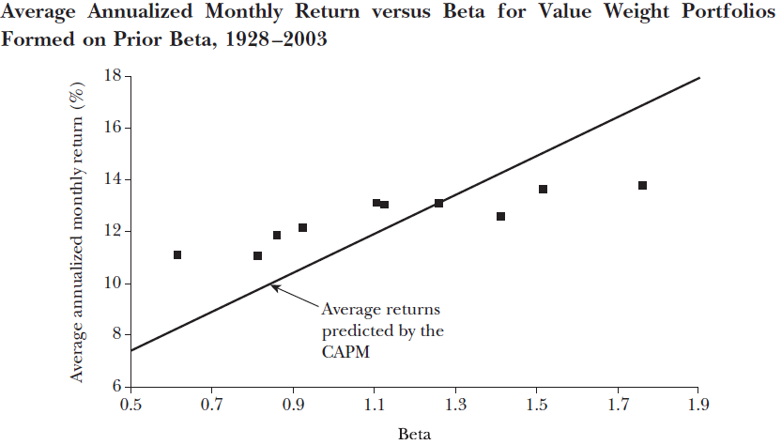
How Does the CAPM Perform Empirically?
Source: Fama and French, 2004
Early tests (Black, Jensen, Scholes, 1972, Fama and MacBeth, 1973) showed beta was priced, that idiosyncratic risk was not priced, but that the expected return on a zero beta portfolio is significantly greater that r_{F}.
But recent evidence finds a very flat relationship between Beta and returns - not as strong as the theory suggests.

Slide 22
Why not just test the CAPM on individual shares?
Obvious way to test the CAPM is to take each share, measure its beta, and regress the average excess return of the share against the beta of the share
The problem is that we cannot measure the beta of a share accurately
much of the variation in measured beta between shares is the result of noise, not market risk
would lead to conclusion that beta can only explain part of the risk premium
But can measure the beta of portfolios much more accurately because most of the idiosyncratic risk is diversified away
if we form portfolios randomly we would have portfolios with betas close to 1 and still could not test CAPM
by forming portfolios based on prior measured beta can get portfolios with good dispersion of beta values

Slide 23
How Does the CAPM Perform Empirically?
Also, a great deal of anomalous evidence has come out suggesting that things other than beta are important in determining expected returns:
The Small Firm Effect (Keim, 1981)
The Book-to-Market Effect (Stattman, 1980; Rosenberg, et al., 1985)
The Momentum Effect (Jegadeesh and Titman, 1993)

Slide 24
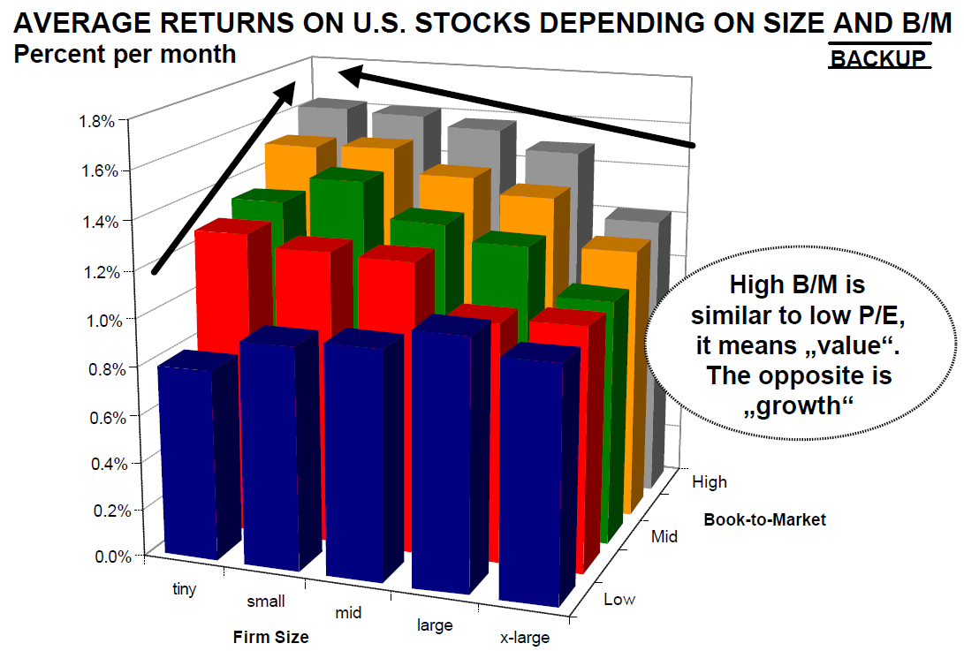
How Does the CAPM Perform Empirically?
Source: Mertens (2002) (http://www.elmarmertens.com/lecturenotes/financenotes)

Slide 25
How Does the CAPM Perform Empirically?
B/M Quintile
Monthly excess returns sorted by Size and B/M quintiles
Source: Fama and French (1993)

Slide 26
Why does the CAPM not work well?
Have actually made some very strong assumptions
Investors only care about mean and variance: but may worry about skewness – would you rather:
200 (Pr 10%) 120 (Pr 90%)
100 or 100 ?
100 (Pr 90%) 20 (Pr 10%)
(Both the gambles have the same mean and standard deviation, but differ in skewness)
all investors care only about risk to wealth next period: but if I am a long term investor I may prefer an investment that pays more if say interest rates are low next period and less if they are high
all investors are indifferent to tax: but some investors may prefer to receive return as capital gain rather than dividends for tax reasons
the stock market is the sum of wealth: but there is a lot of other wealth (real estate, bonds, human capital) and theory says that beta should be estimated on entire wealth portfolio
no transaction costs and unlimited shortselling: but stock market participation is limited, and it is not possible to short sell one’s human capital

Slide 27
Other Issues
Investors have a common information set and interpret it rationally: but not clear how rational agents should form expectations about future events, and significant evidence that investors have biases, bounded rationality
Tests tend to assume stability of parameters: evidence of time varying market price of risk, beta
Many models that try to relax one or other assumption:
models tend to introduce other priced factors (such as dividend yield, sensitivity to other economic variables apart from the market return)
no consensus on a better model
CAPM remains as a flawed standard

Slide 28
Equilibrium Models
So far looked at equilibrium models
characterise demands of investors and find prices for securities that brings supply/demand equilibrium
but empirical results are disappointing
maybe we are being too ambitious given that demands are affected by complex factors
beliefs, fears, superstitions
different endowments, horizons and objectives
existence of substitutes (housing, human capital)
institutional frictions (herding, league tables)
Try a more limited approach: start with a simple description and then explore the impact of arbitrageurs (prices may not be right, but they should not allow easy certain profits)

Slide 29
Conclusion
Key ideas:
With borrowing/lending, one fund
CAPM
Beta
Systematic and idiosyncratic risk
Using the CAPM
estimating beta and the market risk premium
Testing the CAPM
Reading
BKM, particularly Chs 7 and 9.1-9.3

